Slide 1
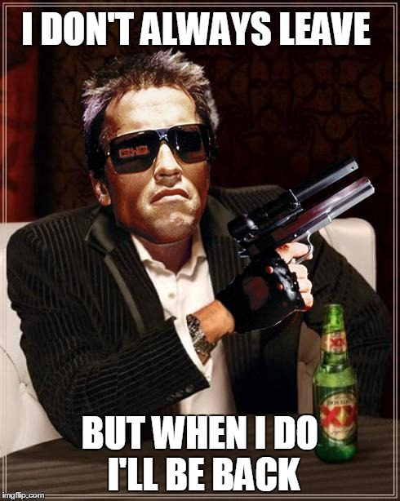

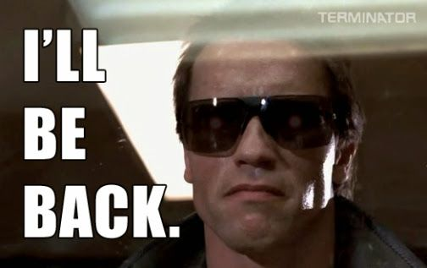
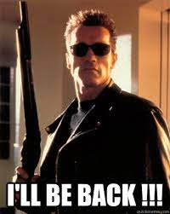
Word Prediction: Which Movie Star Would Be Most Likely to Say a Particular Quote?

Slide 2
Word Prediction: Which Movie Star Would Be Most Likely to Say a Particular Quote?
Work Flow:
Cornell Movie-Quotes Corpus database for quotes per character (2012, from 1068 movie scripts)
IMDB database for movies, movie actors, and roles they played
Pick top 30 actors

Slide 3
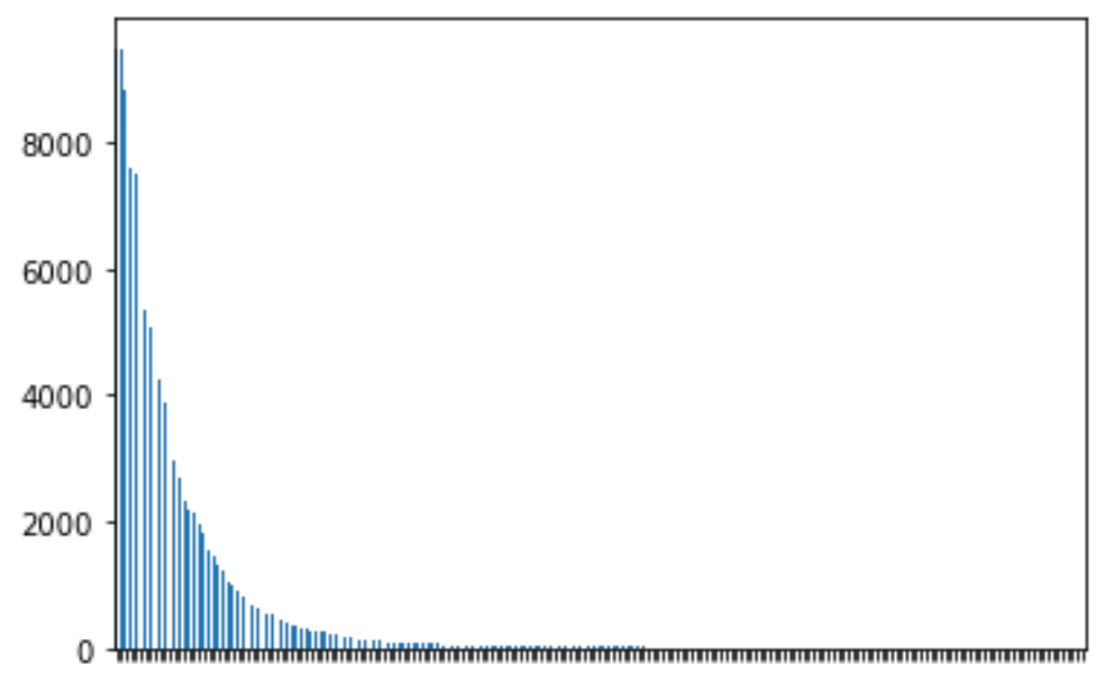
We Optimized Model Quote Length by Analyzing Distribution of Quote Lengths
Length of Quotes for Top 30 Movie Actors
Number of Instances
To optimize performance, we
avoided outliers and used the
.995 Quantile = 89 words
0
563
Number of Words in a String

Slide 4
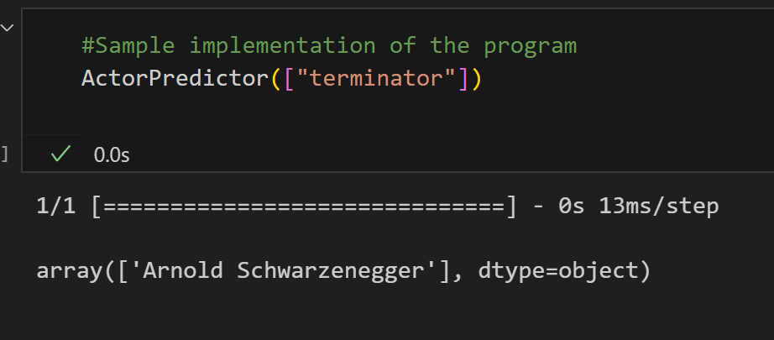
Word Prediction: Which Movie Star Would Be Most Likely to Say a Particular Quote?
Work Flow:
Cornell Cornell Movie-Quotes Corpus database for quotes per character (2012, from 1068 movie scripts)
IMDB database for movies, movie actors, and roles they played
Pick top 30 actors
Train long short-term memory (LSTM) neural net to model quotes for each of the top actors
Write a function for predicting which actor might say a quote

